Slide 1
Data Science Intern Assignment - Postman
Submitted by -
Ujjwal Agarwal
ujjwal101040@gmail.com

Slide 2
Let’s get started
Importing all the necessary libraries.
Load the two datasets using pandas.
Get the shape and info of both the datasets.
Dataset 1 (date) : 541909 rows and 6 columns.
Dataset 2 (sales_data) : 541909 rows and 8 columns

Slide 3
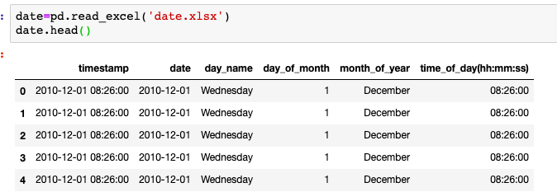
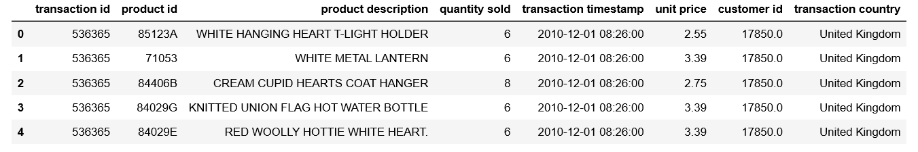
Data Analysis
Dataset 1
Dataset 2

Slide 4
Data Analysis
Dataset 1 provides information about the datetime of the transaction.
Dataset 2 provides complete information about transaction with datetime information in “timestamp transaction” column.
Both the datasets have same number of rows and by visualising both the datasets we can conclude that one column is common in them.
We can join the two datasets based on transaction timestamp column.
Further we can conclude that all the features of dataset 1 can be extracted using timestamp transaction column of dataset 2. So, I decided not to merge both the datasets.
From now, all the analysis will be performed on dataset 2 only.

Slide 5
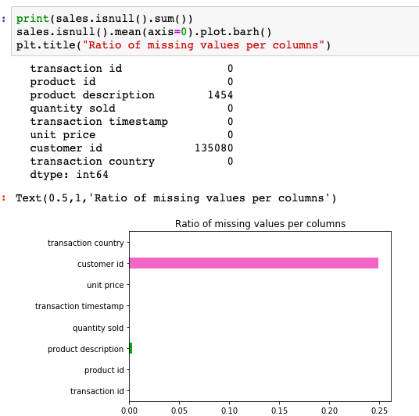
Data Analysis
Got 1454 and 135080 NULL values for product description and customer id column respectively.

Slide 6
Data Analysis Continued..
In our dataset we also have the information about the orders that are being canceled, represented by ‘C’ in starting of the transaction id.
For canceled orders every detail is same as that of purchased order except the quantity sold, which is the negative of purchased order.
In total, we have 9288 canceled orders.

Slide 7
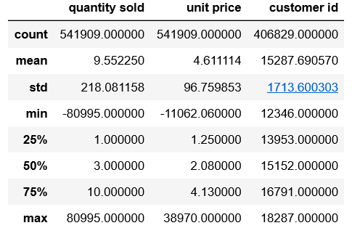
Data Analysis Continued..
Dataset Description - We have some negative values in our dataset. Maybe this could mean that these quantities (with corresponding unit prices) was returned or being cancelled or they were discounted products.

Slide 8
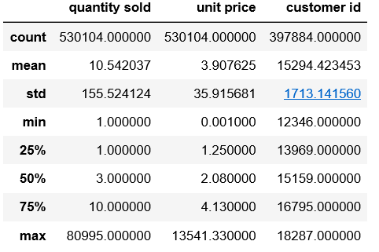
Data Analysis Continued..
Dataset description after removing the negative values of quantity and price.

Slide 9
Data Analysis Continued..
We finally remove the duplicate rows and rows having NULL customer id as we cannot fill any arbitrary value for customer id.
Shape of final dataset : 392692 rows and 8 columns.
At this stage our dataset is completely clean and we can perform further analysis on the same.

Slide 10
Data Analysis Continued..
There are 17282 unique transactions, but only 4338 customers and 3665 products. So, we can conclude that customers are buying products multiple times.
Created a new column Amount (Quantity Sold*Unit price).
Created year, month, day, hour columns from transaction_timestamp column to analyze the change in quantity sold with respect to time.

Slide 11
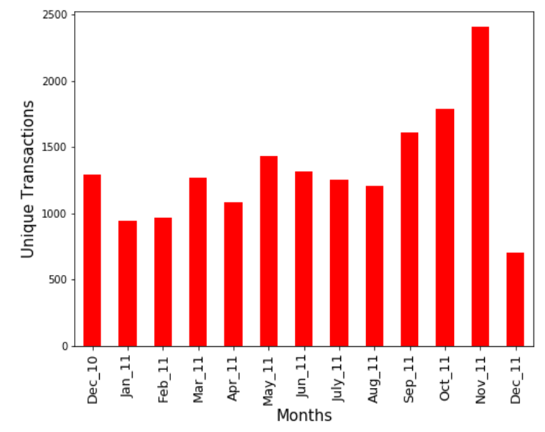
Is the company’s performance improving or degrading over time?
We can visualize that sales do not follow a defined pattern. As there is a slight increment or decrement month-wise but there is sudden increase in sales in november maybe due to some festivals or any other event.

Slide 12
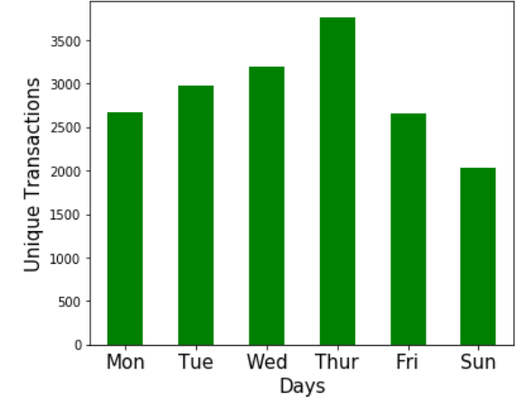
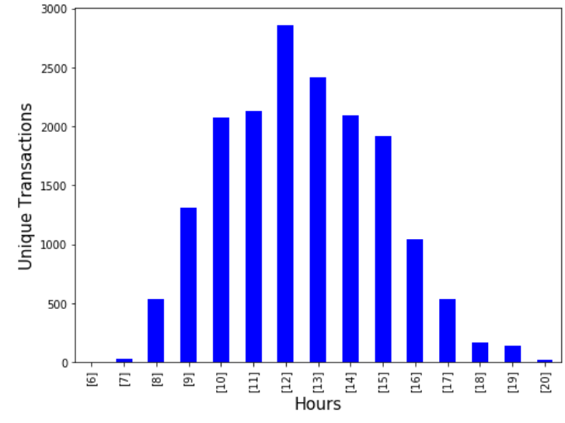
Trends in the sales data and insights
Thursday seems to be the day on which most products are sold and no transactions on Saturday
Majority orders are in afternoon and maximum orders are done at 12 pm.

Slide 13
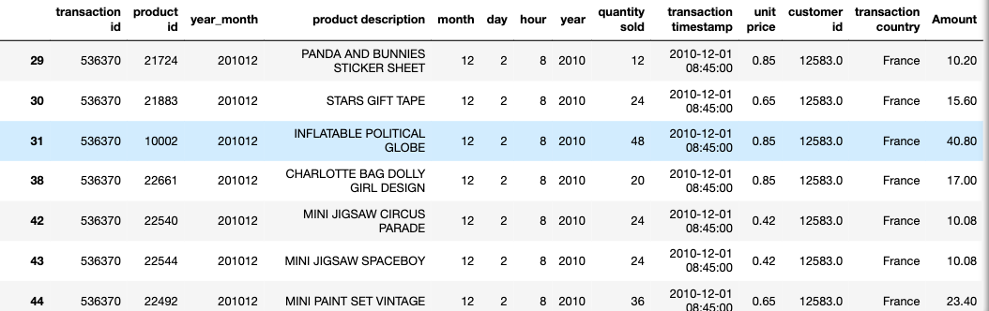
All about Products
There are products with unit price less than 1. They include bank transaction charges, small decoration products like gift, tapes etc.

Slide 14
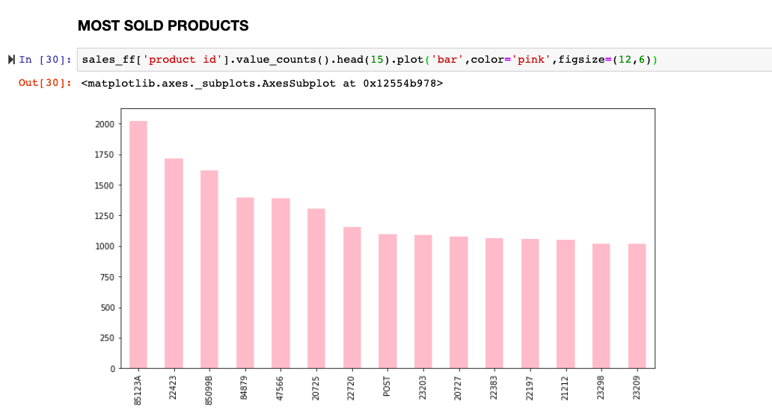

Slide 15
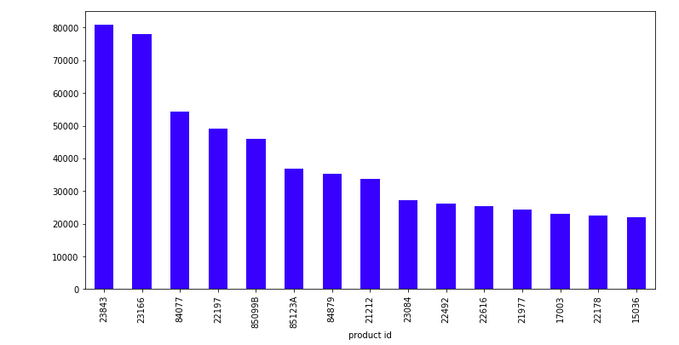
MOST SOLD PRODUCTS (QUANTITY WISE)
Quantity sold

Slide 16
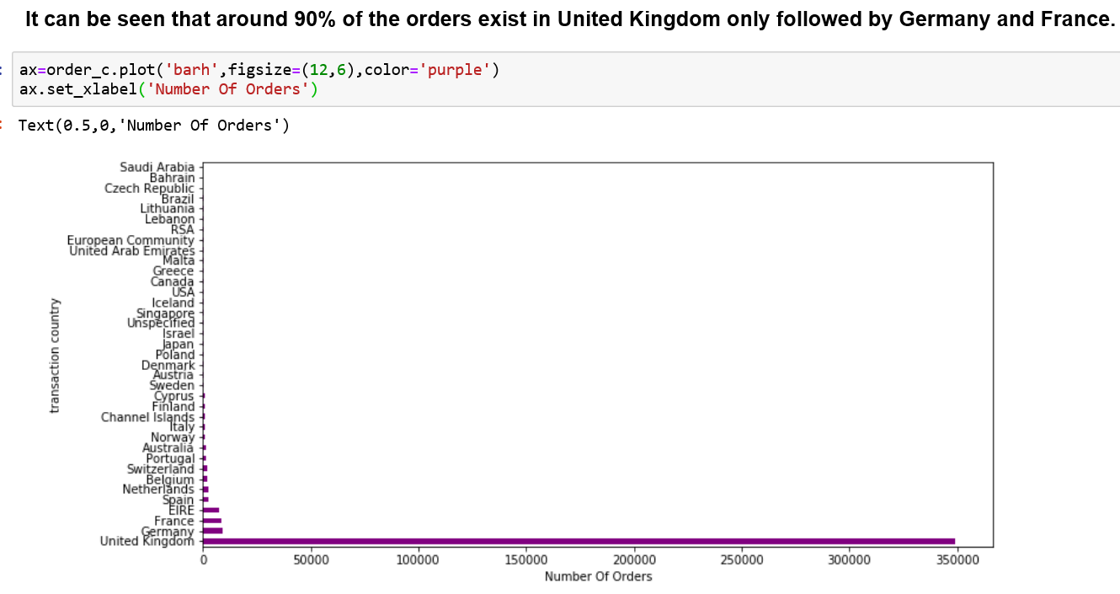
Visualising number of orders for each Country

Slide 17
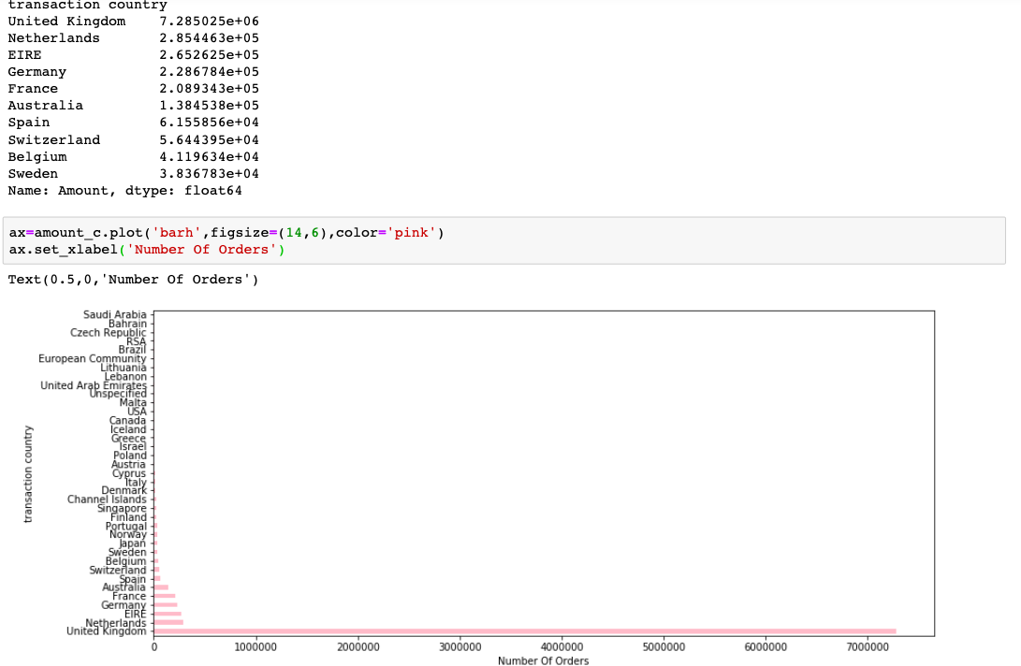
Total Amount spent by each country

Slide 18
Can we take some initiatives to increase sales based on the data to increase sales?
We’ve gathered information country wise for five countries and grouped them by transaction id for each product description so that we can find which two items are frequently bought together using Apriori Algorithm. Understanding these buying patterns can help to increase sales in several ways-
If someone buys one item we can recommend other item also as it is highly likely that the customer may buy second item also.
Promotional discounts could be applied by clubbing both something like combo offer.
Advertisements of one product could be targeted at buyers who purchase another product frequently.

Slide 19
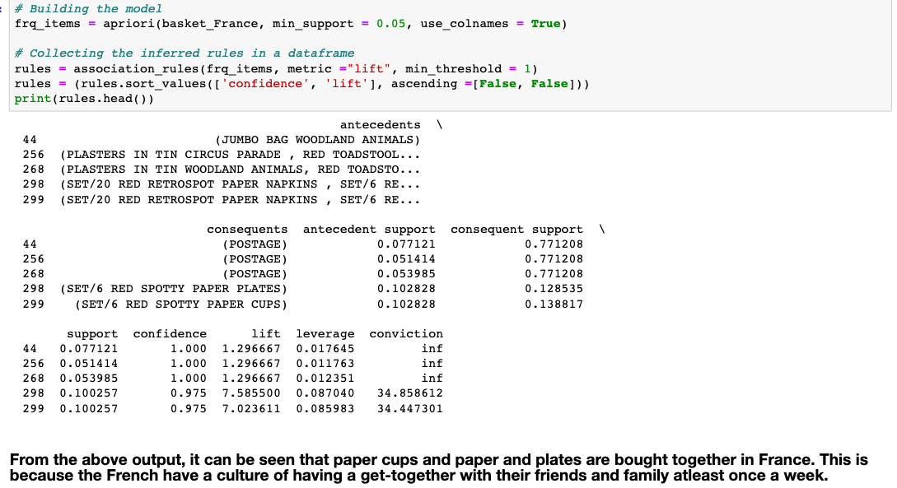
For France

Slide 20
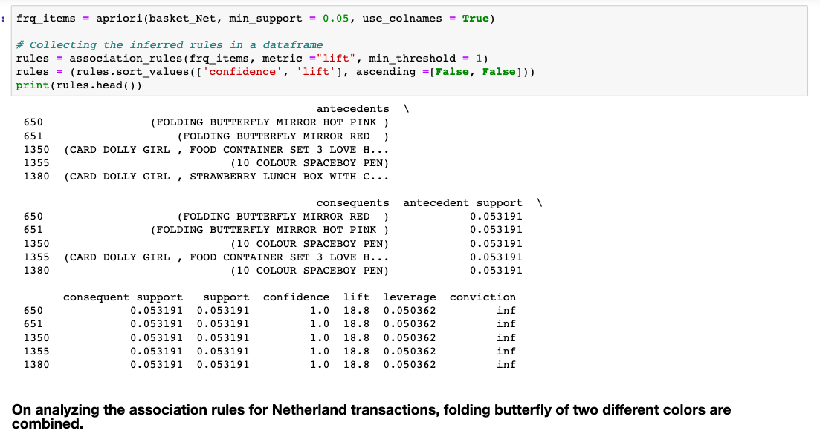
For Netherland

Slide 21
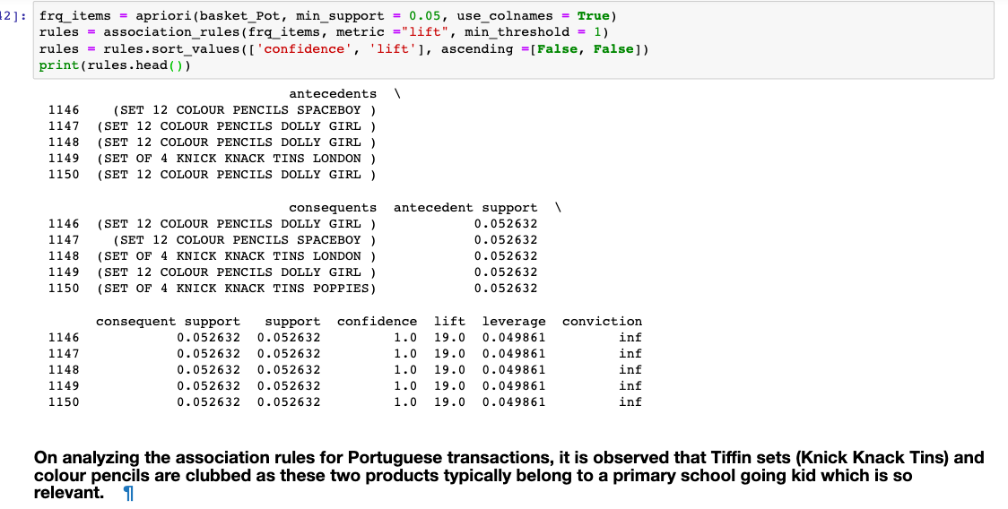
For Portuguese

Slide 22
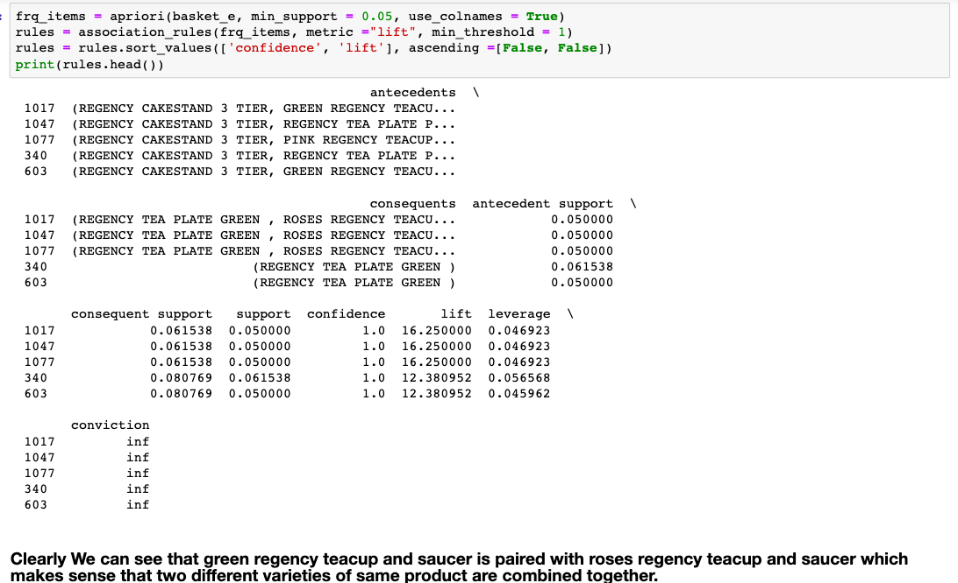
For EIRE

Slide 23
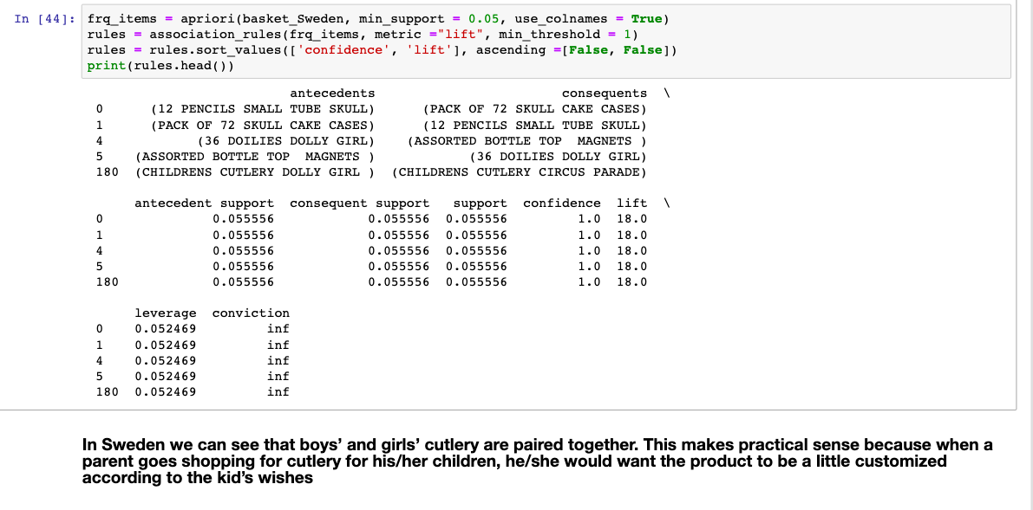
For Sweden

Slide 24
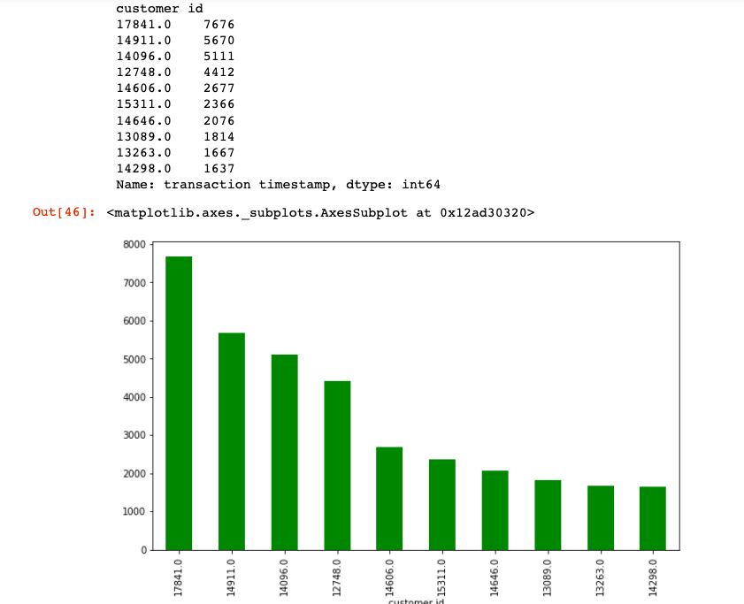
Grouping by Customers and Number of transactions

Slide 25
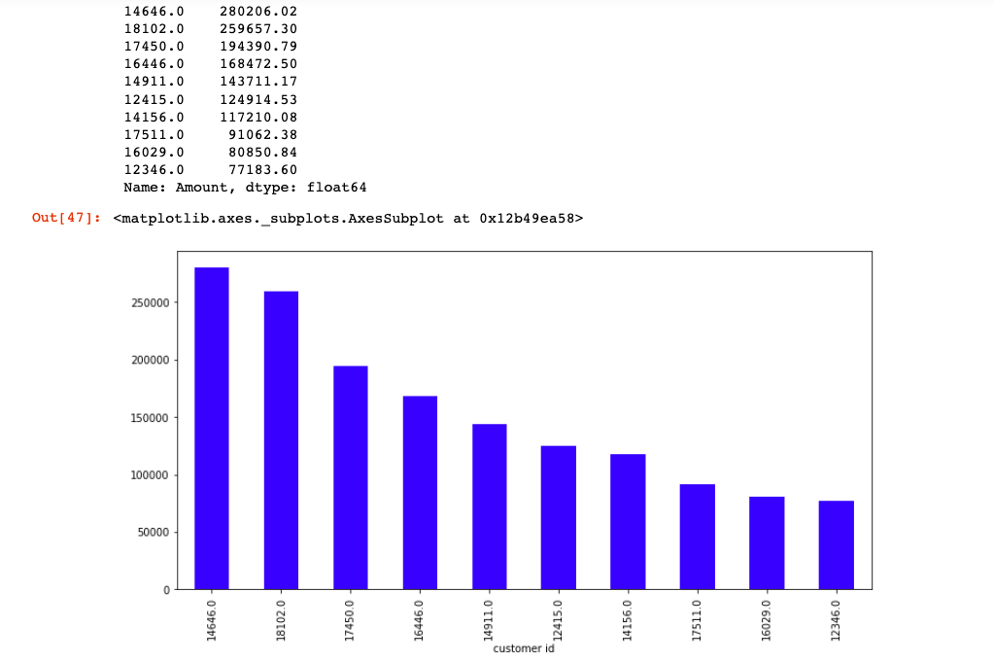
Grouping by Customers and Amount Spent

Slide 26
As we have seen that UK is most important for our analysis. So we are going to apply Recency,Frequency and Monetary(RFM) analysis on UK to segment customers in groups.

Slide 27
RFM, which stands for Recency, Frequency and Monetary value. RFM is a marketing technique that is used to evaluate the behavior of a company’s customers. For example, it can be used to evaluate how recently a customer has purchased a product or a service (recency), how many times the customer has made a purchase since a certain date (frequency) and how much the customer has spent in a given a period of time (monetary).
It can lead to reduced marketing costs by helping you target the right customers
It can help you to identify your best and loyal customers
Companies are able to understand that their customers have different needs and requirements, and therefore respond differently to the company’s marketing campaigns. By looking at our customers via the three key aspects of the RFM analysis model, we can significantly improve our marketing techniques and target our campaigns more accurately to those customers’ desires and needs, which ultimately will boost your response rate and sales.

Slide 28
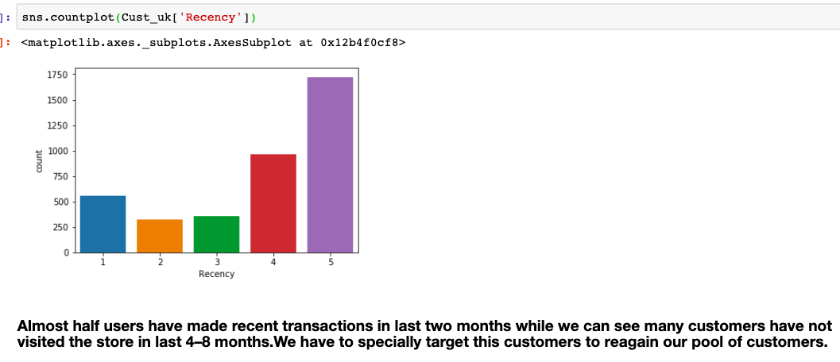
Recency (R)
Recency is the most important predictor of who is more likely to respond to an offer. Customers who have purchased recently are more likely to purchase again when compared to those who did not purchase recently. To tag the customers on the basis of recency flag, we will first filter the customers of United Kingdom and take distinct dates of their purchase.

Slide 29
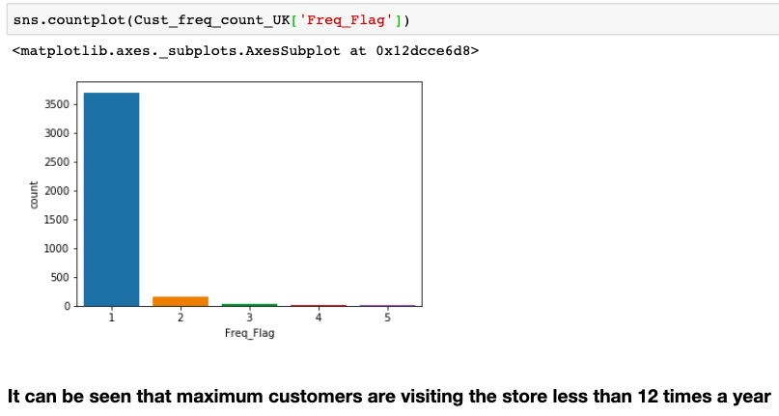
Frequency (F)
The second most important factor is how frequently these customers purchase. The higher the frequency, the higher is the chances of these responding to the offers.To tag the customers on the basis of frequency flag, we will take country wise count of distinct invoice number for each customer and then filter out the customers of United Kingdom.

Slide 30
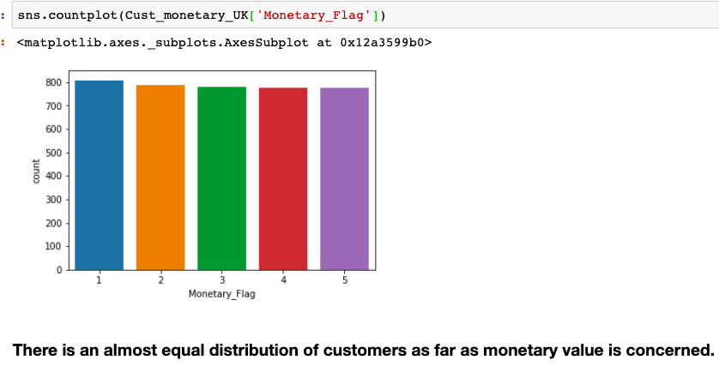
Monetary Value(M)
The third factor Monetary Value is the amount of money these customers have spent on purchases. Customers who have spent higher contribute more value to the business as compared to those who have spent less.To tag the customers on the basis of monetary flag, we will take country wise sum of total price for each customer and then filter out the customers of United Kingdom.

Slide 31
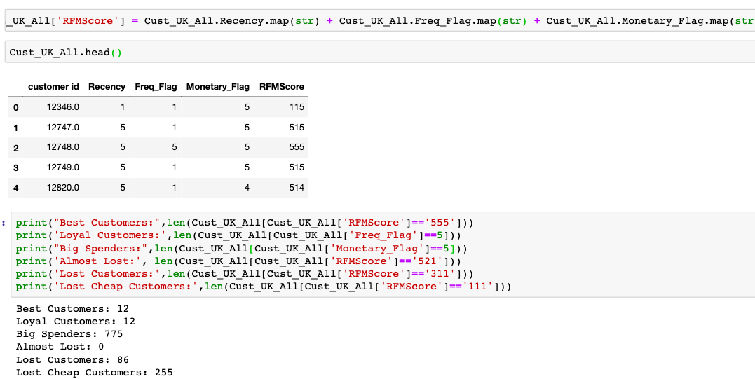
Using total RFM Score,
We are segmenting customers into 6 types.

Slide 32
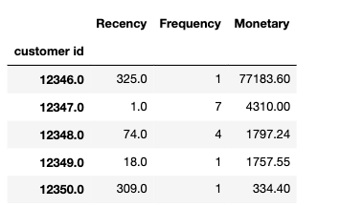
Generalised RFM table for all countries

Slide 33
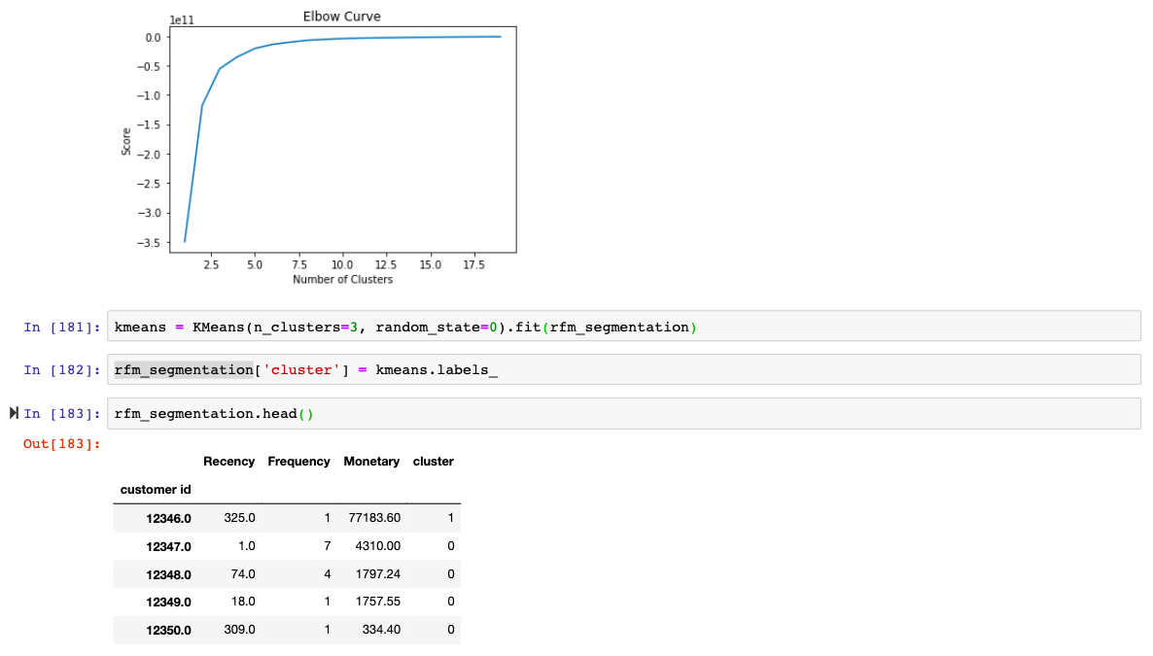
Clustering customers on basis of RFM using K-means
We use elbow curve to find the optimum number of clusters.

Slide 34
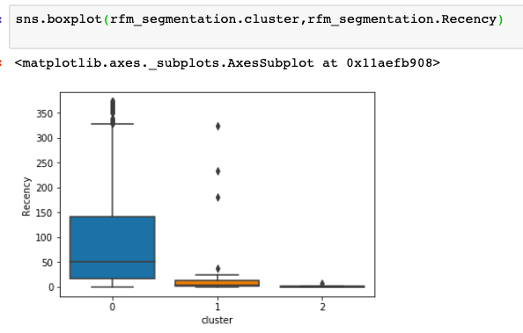
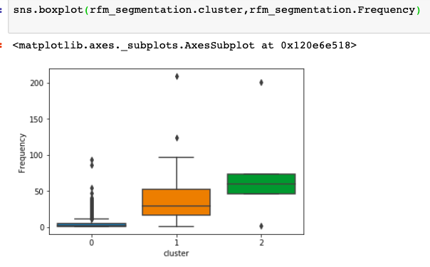
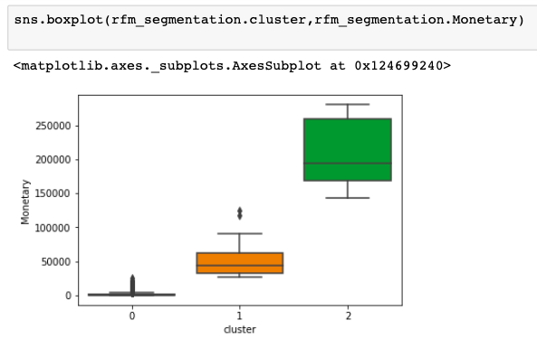
Based on RFM analysis we grouped customers into 3 segments. We found out cluster 1 are Platinum customers, Cluster 2 are Gold Customers and Cluster 3 are Silver Customers

Slide 35
What type of Customers do typically buy from us?
Based on business requirements, various cut-offs are imposed on each of the three parameters. After applying the cut-offs, customers can be classified mainly in six segments:
1. Best Customers-Bought recently, buy often and spend a hell of a lot of money. Make them feel important and appreciated. We need to tell them about launch of new products and introduce a loyalty program for them so that they can get benefitted.
2. Loyal Customers- Most regular, loyal and reliable purchasers. Have a high rate of growth in Frequency but may or may not remain constant in the Recency and Monetary Value scores. Always keep coming back for more, easily sign up for loyalty programs that appeal to them, responsive to promotions, just politely remind them. Ask relevant questions when they leave reviews to help in improving the health of the brand

Slide 36
3. Big Spenders-Very wealthy, maybe a residence of the dukes or something, they have a lot of money, and unable to stop themselves spending it over the lifetime of your relationship. Usually content themselves with a few big purchases, or with a few small ones. Motivated enough with your products or services to spend a lot more later. We have to target them with the most expensive high-end items.
4. Almost Lost Customers-Valuable customers that purchased frequently and spent big money, but some time ago, at risk of being lost for good. We can create and implement moderate and personalized retention strategy with more competitive pricing, new product launches, send emails to reconnect, reach out
5. Lost Customers-Best customers that were lost. Requires aggressive price incentives and reactivation campaigns. We can also send a customer survey and get the feedback on why they left: poor experience, seasonal products or a ‘one-time’ thing. We can revive their interest with promotional incentives of more aggressive discounts off a range of products based on past purchases.
6. Lost cheap Customers-Spent as little as possible, bought very few goods, all orders from a long time ago. Extremely unlikely source of repeat purchase, doesn’t really worth time and trouble. I think we should not spend on these customers

Slide 37
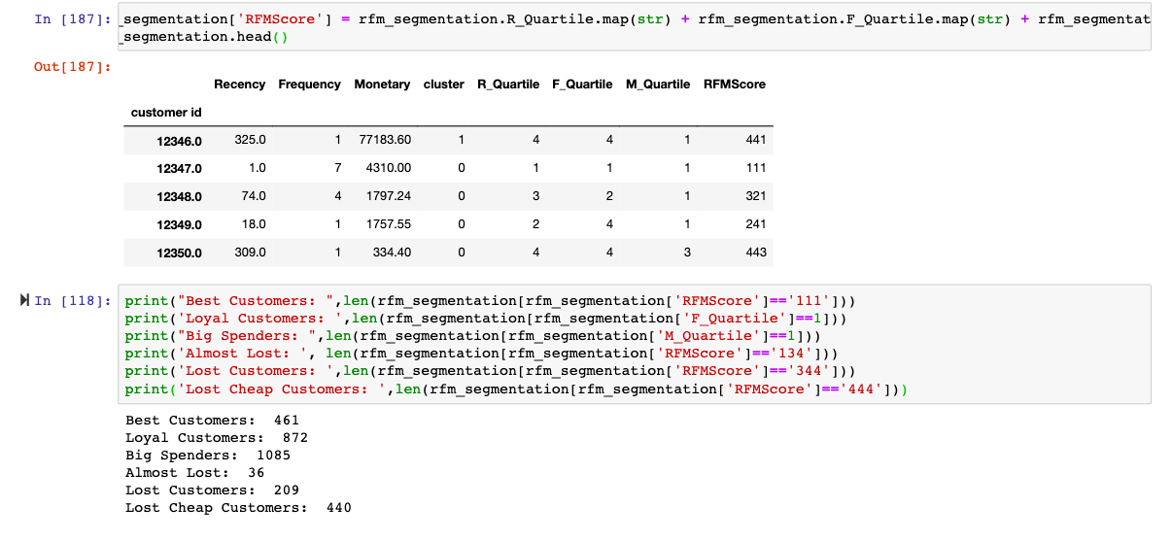
6 Segments

Slide 38
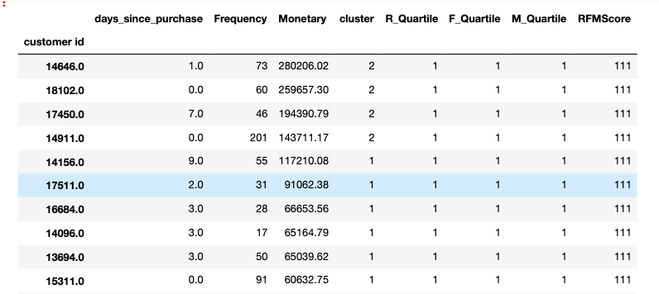
Best Customers

Slide 39
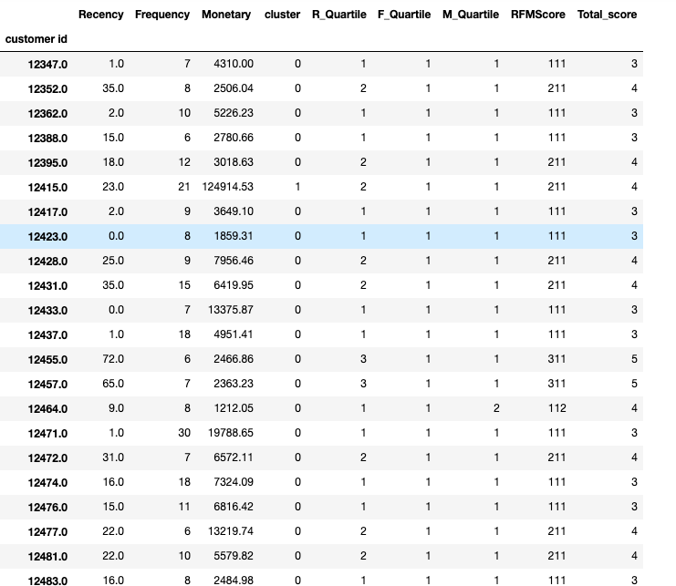
Loyal Customers

Slide 40
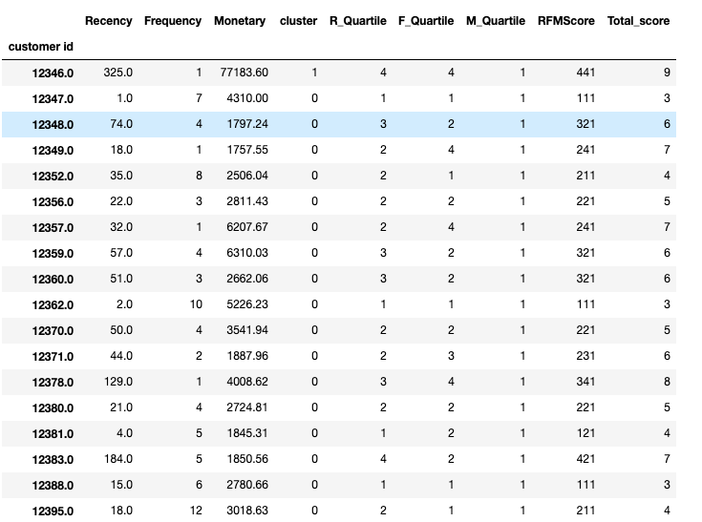
Big Spenders

Slide 41
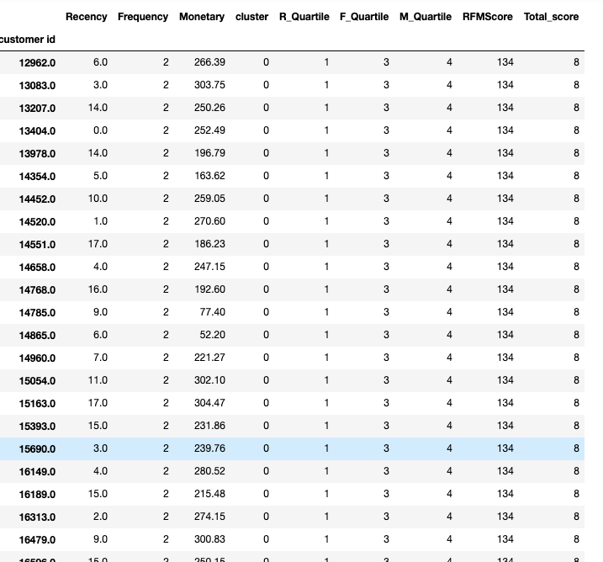
Almost Lost Customers

Slide 42
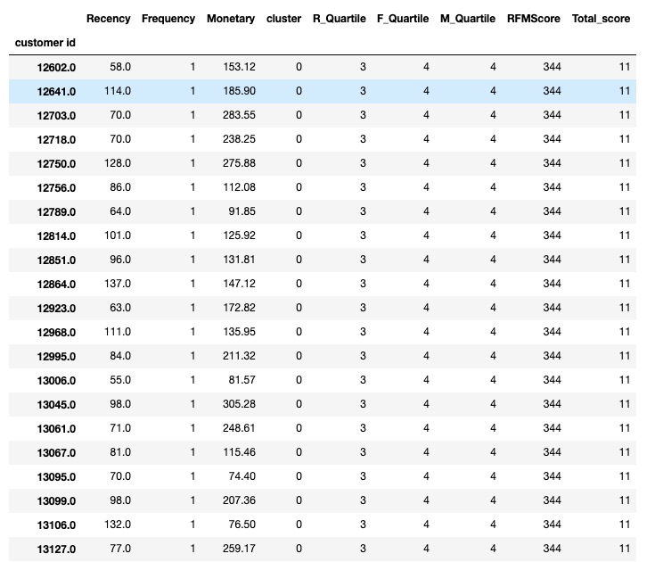
Lost Customers

Slide 43
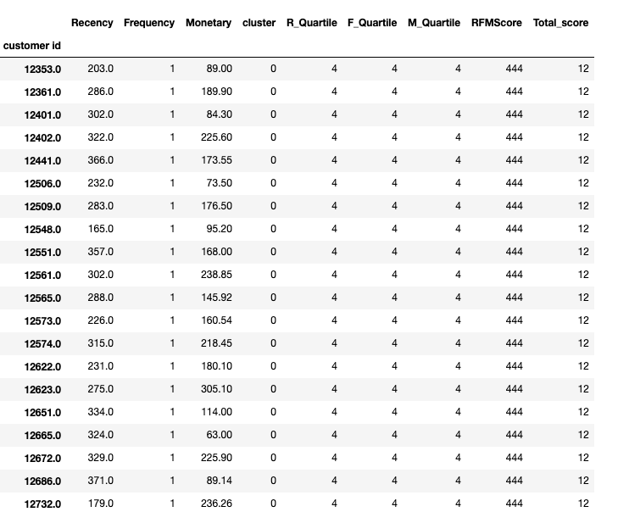
Lost Cheap Customers

Slide 44
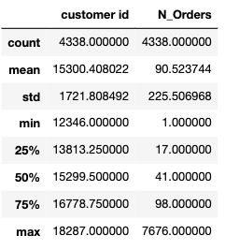
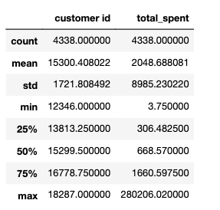
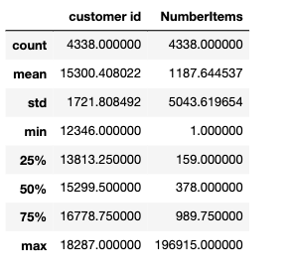
Clustering of Customers based on Number of items,Total Amount and Number of orders made

Slide 45
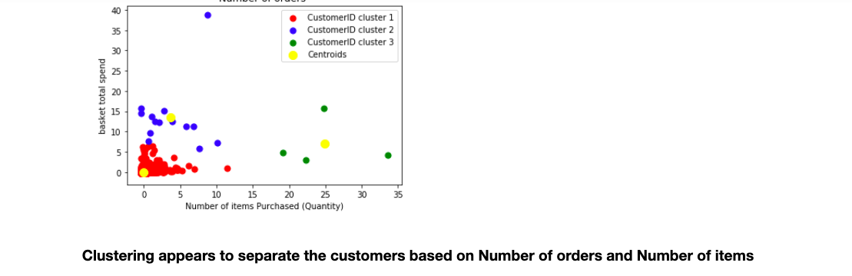
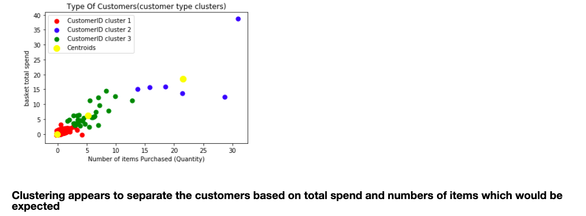
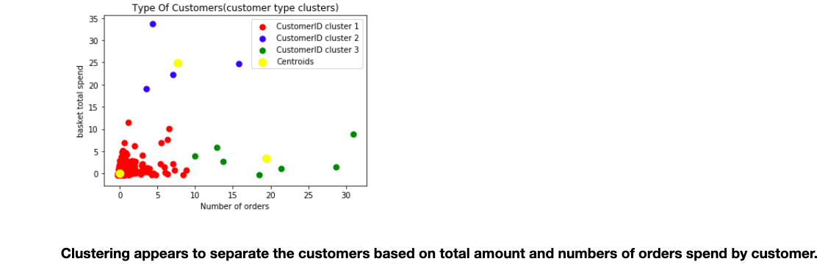
Different type of Clustering

Slide 46
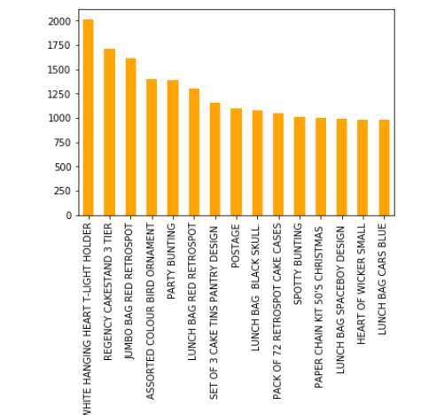
Product Description
There are 3877 unique product descriptions. We can see in graph that some descriptions correspond to a similar product type. We can see the multiple occurences of lunch bags as we often have color information about the product as well. Furthermore the most common descriptions seems to confirm that the retailer sells various different kinds of products

Slide 47
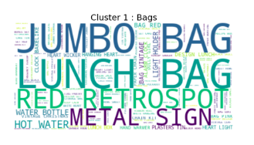
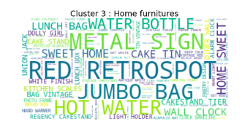
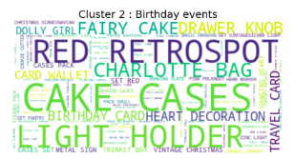
Clustering on basis of Product Description
We have formed three clusters of customers purchase based on product description in the dataset. Cluster 1 depicts some information about bags and Cluster 2 depicts products about birthday events . Cluster 3 generally show some home furniture things.We have used Wordcloud to depict these clusters.

Slide 48
How can we measure our performance in terms of customer acquisition and building customer loyalty?

Slide 49
Cohort Analysis
Cohort Analysis is a metric which depicts the user acquisition rate.
It is always a good idea to know how your users behave in a product or toward a marketing event aligned with time series. User acquisition is a huge and significant action for a product.
Cohort analysis breaks into related groups for analysis. These related groups, or cohorts, usually share common characteristics or experiences within a defined time-span.
Cohort analysis is a tool to measure user engagement over time. It helps to know whether user engagement is actually getting better over time or is only appearing to improve because of growth.

Slide 50
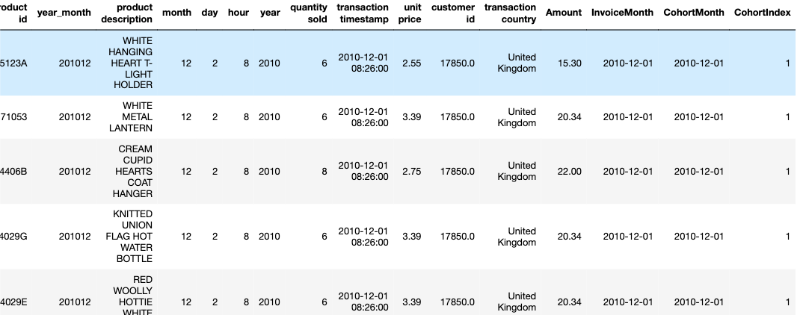
We made a new column cohort month, it is the first month for the specific user ID when that user shopped at this online retailer. The groupby and transform are used for creating the cohort month.
Finally, I created a cohort index for each row. The cohort index is the month difference between invoice month and cohort month for each row. By doing the deduction, I am able to know the month lapse between that specific transaction and the first transaction that user made on the website.

Slide 51
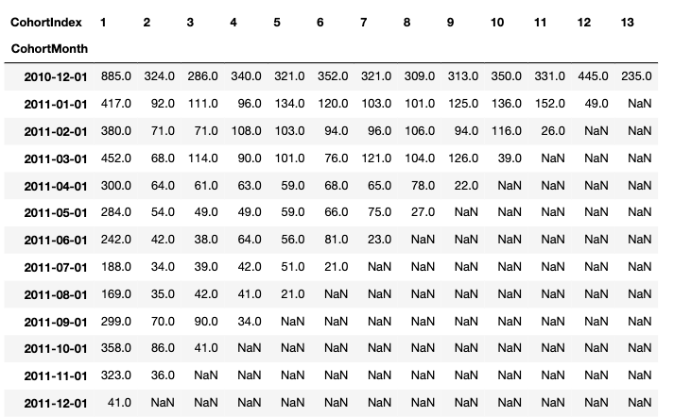
I created first Cohort which depicts number of active users. I used group by and pivot table functions.
In this table, first column is active user number on that specific month, and the following columns show how the many remaining users are still using the service on the second, third, and fourth month. The 13th column and 2010–12–1 row means 235 users out of 885 users were still buying things after the 13 months from 2010/12/1.

Slide 52
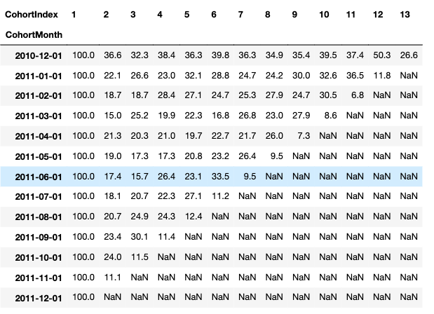
Based on previous data frame, I can further transform the absolute number into percentage to showcase the retention rate. First column is no doubt 100% retention rate, and with time going by, the retention rate would drop.

Slide 53
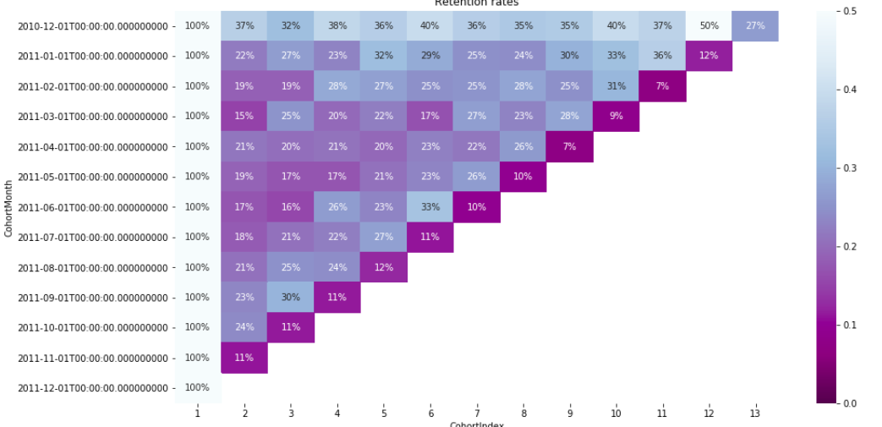
Finally, I am able to visualize more clear result using Seaborn heatmap. From the graph, it can be concluded that on 2011/11 some strategies might be implemented to increase the return users as about 50% of user from 2010/12 cohort return on 2011/11. We should investigate these type of campaigns or feature changes that lead to the higher retention.

Slide 54

Can we avoid out of stock situations?
Calculated month wise quantity sold for each product - We assume that if a product is sold in a given quantity in the given month. So, in the same month next year quantity sold will be more likely equal to that of previous one. We therefore, try to keep the same or just greater quantity to avoid out of stock situation.

Slide 55
The goal is to turn data into information and information into insight.

Slide 56
Thank You

